Slide 1
Cluster Analysis of popularity
of various car manufacturers
from around the world
using Python
A Presentation by
Mohammed Abdullah (27830 – Group 14)

Slide 2
What is Cluster Analysis?
Cluster analysis is a statistical method for processing data. It works by organising items into groups, or clusters, based on how closely associated they are.

Slide 3
Hierarchical Clustering
An Unsupervised Method to group data.
Resulting Clusters are displayed in a Dendrogram.
Easily understood and interpretable.

Slide 4


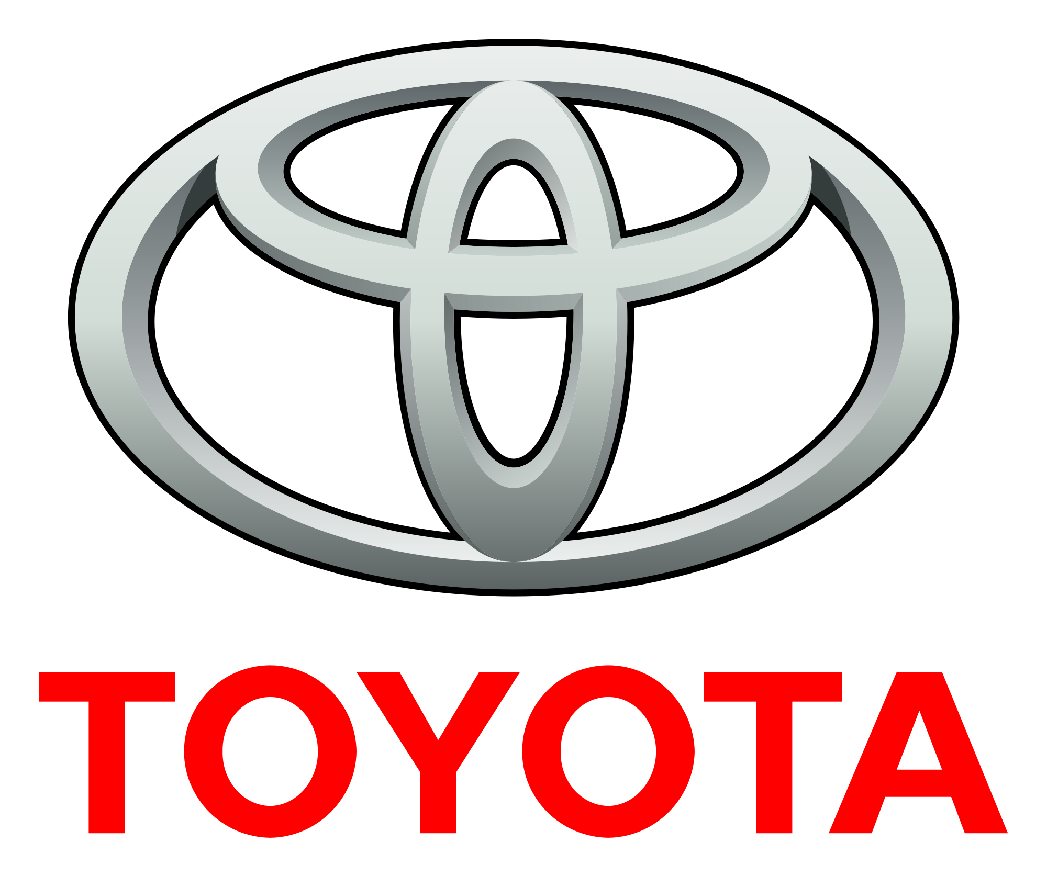

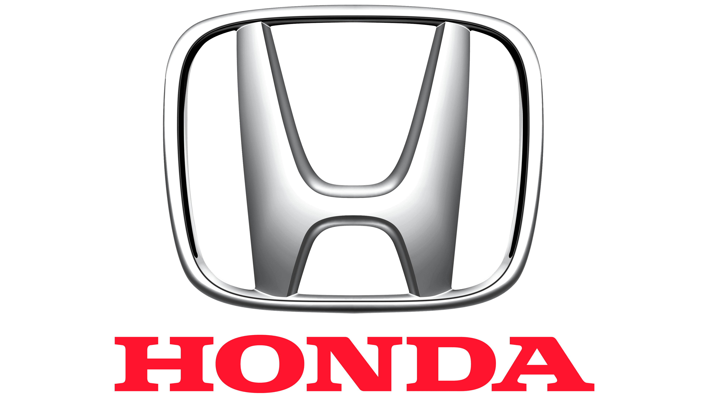

Collected Data

Slide 5
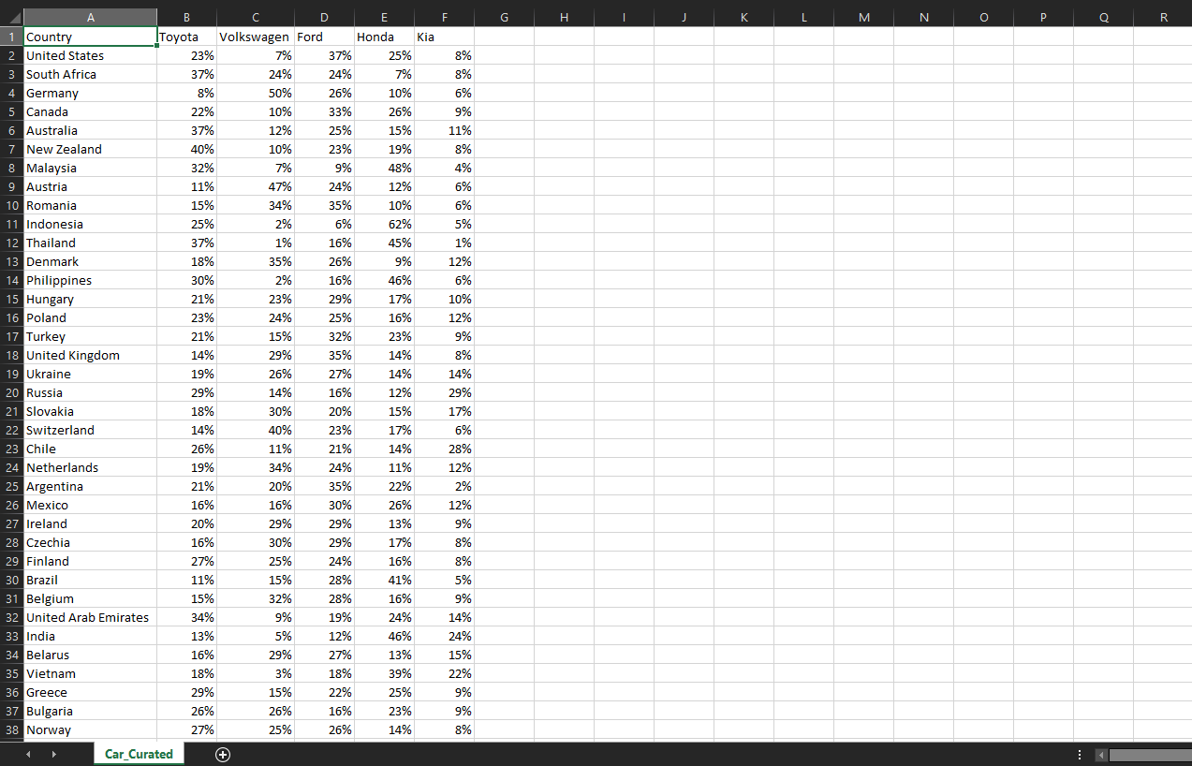
Peek at the CSV File

Slide 6
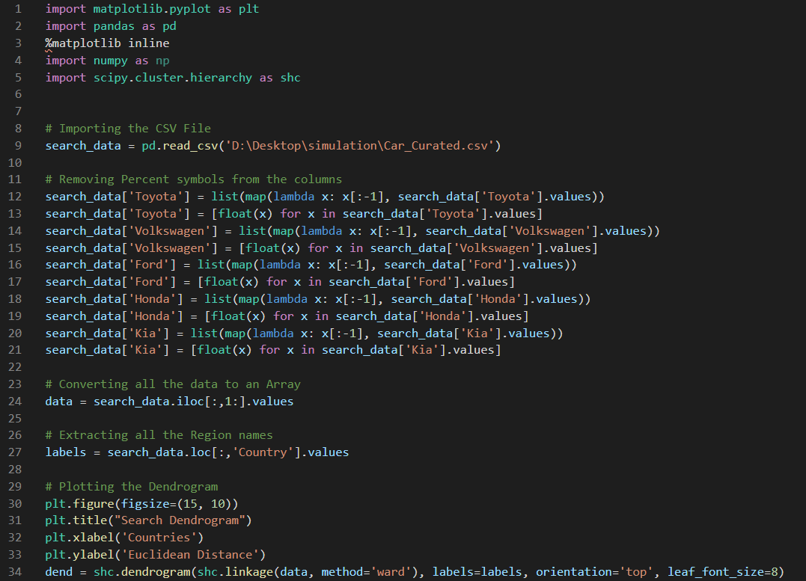
Peek at the Python Code

Slide 7
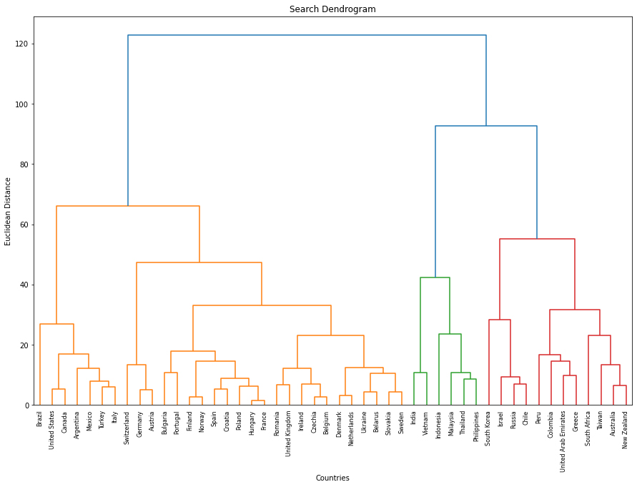
The Dendrogram

Slide 8
Thank You!

